Slide 1
Spotlight 9
Module 3. See it to believe it.
Unit 3f. English in Use.
Phrasal Verbs: COME

Slide 2
Phrasal verbs: COME
Come across | meet or find by chance | случайно встретиться или найти
Come down with | get an illness, often not a very serious one | заболеть чем-либо не очень серьезным
Come over | affect somebody strongly | овладеть (о чувстве)
Come out | become available to the public | опубликовать; выходить на экран
Come up with | think of an idea | предлагать идею

Slide 3
ACROSS
DOWN WITH
COME
OUT
OVER
UP WITH

Slide 4

across
She came ________ a pile of old books while she was clearing the attic.

Slide 5

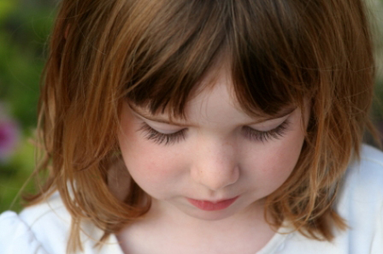
I’m sorry – I don’t know what came _______ me. I don’t know what made me behave in that way.
over

Slide 6
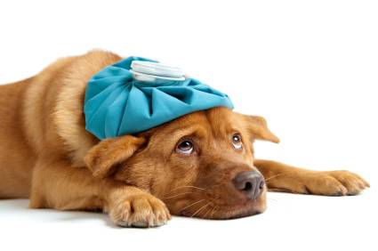
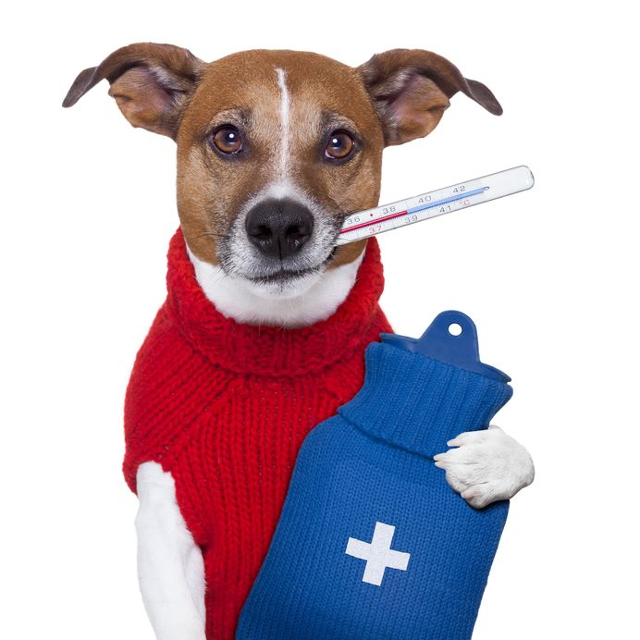
down with
I think I’m coming ________ something. I have a temperature.

Slide 7


He came ________ a great idea for the story.
up with

Slide 8
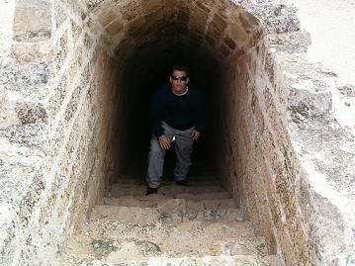
across
Dave came ______ a secret passage in the castle.

Slide 9
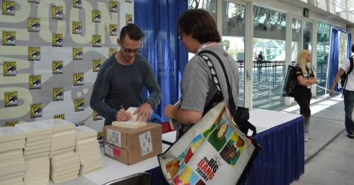
His new novel has just come ________.
out

Slide 10
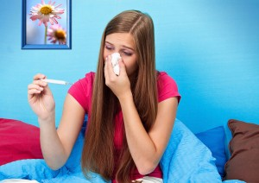
down with
I came _________ a bad cold yesterday.

Slide 11

She came _______ a great idea for solving the problem.
up with

Slide 12

Stephen King’s new book has just come ________.
out

Slide 13
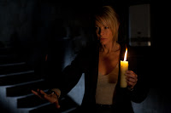
As soon as I stepped into the creepy house, a strange feeling came _______ me.
over

Slide 14
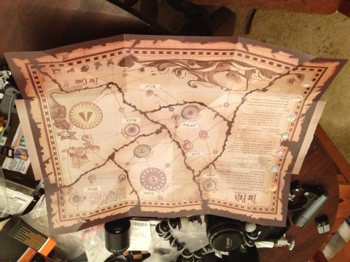
Alan came ________ a mysterious map in his grandmother’s house.
across

Slide 15
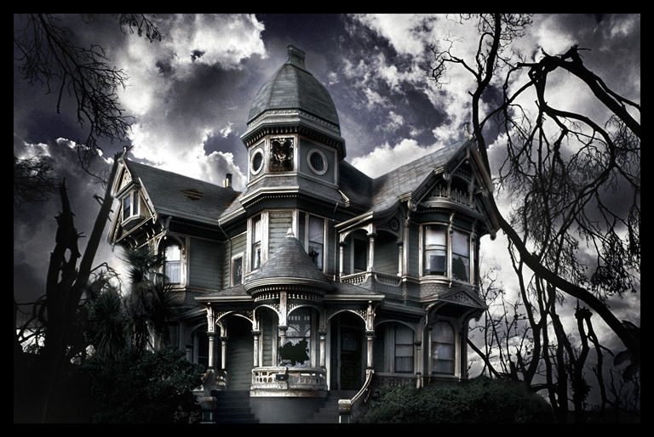
It was Will who came _______ the idea of going into the haunted house.
up with

Slide 16
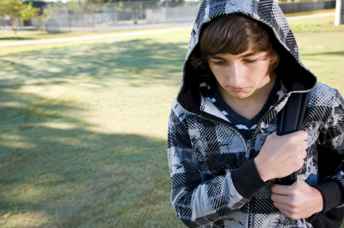
A strange feeling came ________ me as I walked home.
over

Slide 17

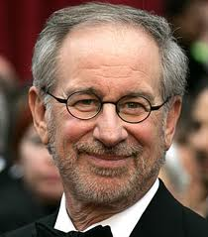
I can’t wait for Spielberg’s new film to come _______.
out

Slide 18
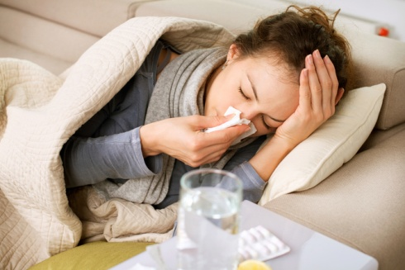
She feels ill. She must be coming _________ the flu.
down with

Slide 19

When do the exam results come ________ ?
out

Slide 20
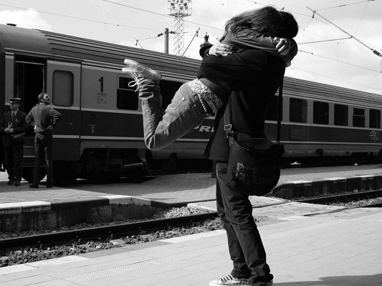
I came _________ him at the station.
across

